Slide 2
Chapter 1: Introduction
Part A: Core Concepts
Part B: The Practicalities
Rationale, Scope and Background of Cultural Risk Assessment and CIERA
Chapter 2:
Chapter 8:
Cultural Risk Assessment & The Cultural Inclusivity and Equity Risk Assessment (CIERA)
Chapter 3: Cultural Risk – EEDI and Bias
Activating Theory -
England and Wales Cricket Board
Chapter 9:
Chapter 4: The Science of Inclusion and Bias
Managing Organisational Risk: Integrating Cultural Risk Awareness into Corporate Governance
Chapter 10:
Chapter 5: Culture
Chapter 11:
Comparing faith in cultural contexts: In Sacred Spaces and on the Dancefloor
Chapter 6: Theories and Frameworks
Chapter 12:
Activating Theory - Action Research with Faith Leaders for the British Ritual Innovation in COVID
Chapter 7: Cultural Intelligence (CQ)
Chapter 13:
Between the lines -
Conversations in Context, a Dialogical Approach
Part C: Case Studies
CS 1: Sweden – Religious Heritage
CS 10: UK – Faith and Sexuality
CS 2: UK – Sensory Rooms
CS 6: Qatar – Football World Cup
CS 11: UK – Cultural Events
CS 3: England – Prom Events
CS 7: USA – NFL
CS 12: USA – Belonging and Ethnicity
CS 4: UAE – Cultural Awareness
CS 8: Japan – Cultural Heritage
CS 13: Caribbean – Diaspora Communities
CS 5: Australia – Indigenous Communities
CS 9: UK – Sport and Gender
CS 14: Nigeria – Business Events

Slide 3
Chapter 1: Introduction
Ruth Dowson & Bernadette Albert
Introduction to the book
  Introduces the Cultural Risk Assessment, an innovative element of the events process, to support the development of more inclusive events and event spaces
  Contextualises cultural risk within traditional health and safety risk assessments
  Based on professional practical events experience, teaching and research
Structure and contents of the book
  Part A develops the academic basis of the core concepts involved in developing the concept of cultural risk.
  Part B discusses the practicalities of cultural risk, offering examples and suggestions for gaining expertise in this vital area.
  Part C offers international case studies

Slide 4
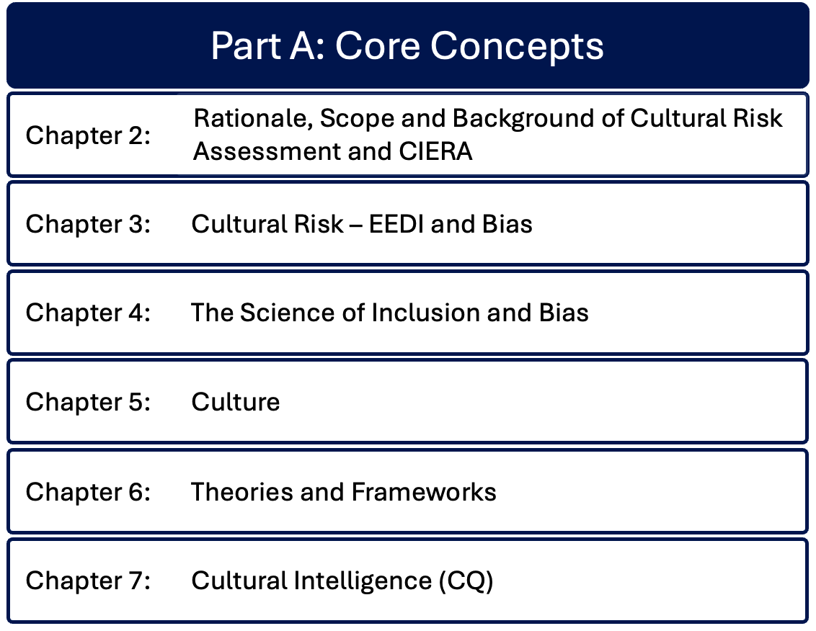

Slide 5
Chapter 2: Rationale, scope and background of cultural risk assessment and CIERA
Ruth Dowson & Bernadette Albert
The story of developing cultural risk from teaching events through implementation across multiple projects and sectors.
Introduces key concepts of academic origins of cultural risk: culture, developing cultural capital; space navigation; creating psychological safe spaces; diversity, inclusion, equity and equality; unconscious bias; venuefication; eventization of faith.
These definitions and the development from the cultural risk assessment into the Cultural Inclusivity and Equity Risk Assessment (CIERA©) form the foundation for the remaining chapters

Slide 6
Chapter 3: Cultural risk - EEDI and bias
Bernadette Albert
Considers EEDI in contemporary cultural and professional settings, with a contextual explanation of EEDI from historical perspectives
Discusses: intersectionality and super-diversity, exploring their relevance to the events industry to create more inclusive spaces and events; theoretical backgrounds to diversity, equity, equality, and inclusion, connecting them to cultural risk on a practical level; cultural risk as a lens for creating inclusion and representation; power dynamics and unconscious bias from its cognitive foundations; the impact of System 1 and System 2 brain on unconscious bias and stereotyping.

Slide 7
Chapter 4: The science of inclusion and inclusivity Bernadette Albert & Ruth Dowson
Historical and contemporary academic significance of inclusion, tracing the philosophical origins of inclusion to Plato and its resurgence in modern social policy to address inequalities and provide equal opportunities for all.
Emphasizes the importance of creating environments in which diversity is valued, and individuals feel respected and supported.
Theoretical frameworks: Social Identity Theory, Critical Race Theory, Intersectionality, Human Capital Theory, Post Colonial Theory.
Barriers to inclusivity: systemic, cultural and structural obstacles, the role of power dynamics and privilege in shaping inclusion.
Need for a nuanced approach to inclusivity, considering the complexities of intersectionality to create inclusive environments that celebrate diversity.

Slide 8
Chapter 5: Culture
Bernadette Albert
Explores definitions of culture, its components and complexities, reviewing key theories from sociological and historical perspectives.
Discusses the criticality of cultural identity where norms, values, beliefs support individuals navigating and becoming embedded in the social structure, providing opportunities for social cohesion.
Considers the impacts of globalisation, cultural diffusion and acculturation on culture, where cultures interact and blend, forming hybrids.
Acknowledges criticality of cultural resilience in preserving and protecting cultural heritage amidst external pressures to adapt, change or be lost.
Underscores the enduring and evolving nature of culture in a connected and globalised world.

Slide 9
Chapter 6: Theories and frameworks
Bernadette Albert
Examines key theoretical frameworks of culture, developing an understanding of culture by addressing frequently utilised frameworks like the cultural web and the cultural iceberg, transitioning to more complex theories: Hofstede’s cultural dimension theories and Hall’s high and low context cultures.
Unpacks Bourdieu’s theory of cultural capital and space navigation, as social positioning and knowledge influence and shape cultural opportunities and interactions.

Slide 10
Chapter 7: Cultural Intelligence (CQ).
Bernadette Albert & Ruth Dowson
Conceptualises the various dimensions of Cultural Intelligence (CQ) and its significance in the event industry, through its cognitive, behavioural, motivational and metacognitive aspects.
Values awareness and adaptability in forming new cultural cognitive schemata, supporting cultural agility.
Promotes the importance of event organisations and their leadership transitioning away from ‘traditional’ hard skills towards cultural intelligence as the new ‘hard skill’.
Justifies why CQ is fundamental for event managers to excel in diverse globalised event environments and how its development feeds into EEDI strategy and systemic transformation, with tools and models presenting the Cultural Intelligence development framework.

Slide 11
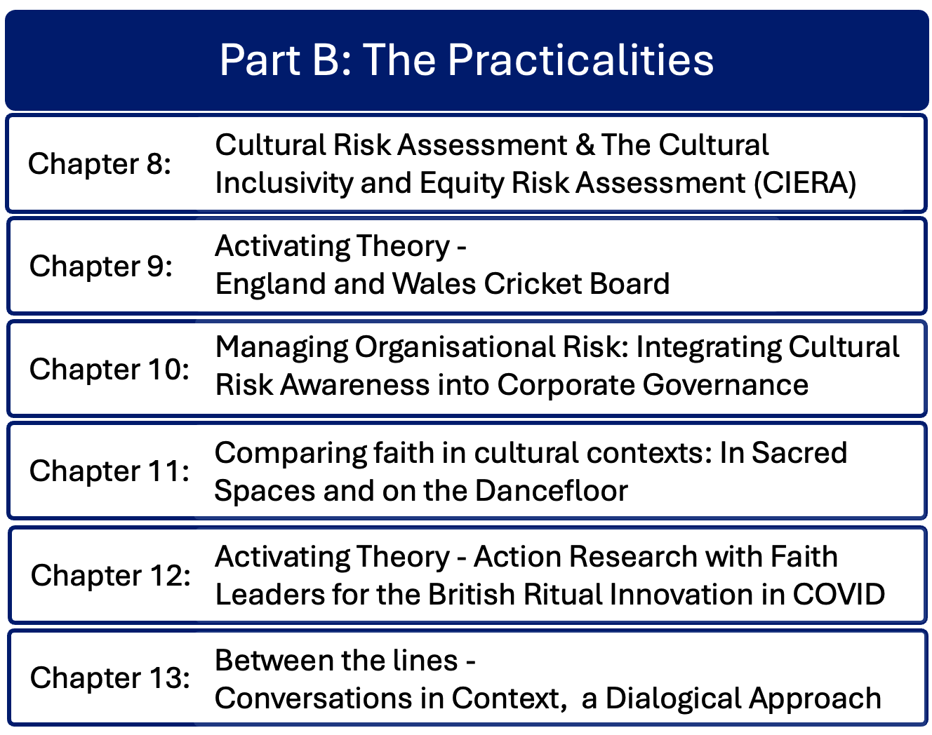

Slide 12
Chapter 8: The Cultural Risk Assessment and the Cultural Inclusivity and Equity Risk Assessment Bernadette Albert
Discusses the practicalities of cultural risk, offering examples and suggestions for gaining expertise.
Continues the story of developing the cultural risk assessment and the CIERA©.
Reflects on variations in culture and the need for cultural intelligence imperative to cater for variations in diverse contexts
Examines closely the details, structures and processes that comprise the CRA and CIERA©

Slide 13
Chapter 9: Activating theory – England and Wales Cricket Board
Ruth Dowson & Bernadette Albert
A 2022 research project for the England and Wales Cricket Board (ECB) to review cricket events and venues, assessing cultural risks and proposing mitigating actions.
Applied classroom theory to professional practice visiting 4 English county cricket stadia, analysing them as venues
Aimed to support cricket event organizers and venue managers in creating inclusive environments to encourage greater diversity for sports teams, other staff, volunteer teams, and attendees.
Recommended consistent training and communication among staff, and strategic leadership in EDI

Slide 14
Chapter 10: Managing organisational risk – Integrating cultural risk awareness into corporate governance.
Rachel Lomax & Dan Lomax
Conversation with the ex-Deputy Chair of the British Council and ex-Deputy Governor of the Bank of England
Considers better management of organisational risk by integrating awareness of cultural risk into the domain of corporate governance
Considers the role and composition of boards of directors and wider corporate leadership in setting organisational purpose and mission.
Outlines audit, risk and regulatory responsibilities, and summarises issues of cultural risk from a corporate governance perspective.

Slide 15
Chapter 11: Comparing faith in cultural contexts – in sacred spaces and on the dancefloor.
Gavin Mart, Ruth Dowson & Dan Lomax
Compares aspects of faith in two different cultural contexts: in sacred spaces and on the dancefloor.
Identifies theological foundations and cultural immersion explored by churches, connecting cultural risk to the process of eventization of faith.
Identifies elements of faith-based events activity that benefit from incorporating analysis of cultural risk into strategic planning.
Discusses safeguarding and limitations of leadership when engaging in cultural activities, offering a new model of cultural engagement.
Compares secular events from the music industry and the dance floor, summarising the complications that arise from faith organisations adopting cultural practices of the secular world.

Slide 16
Chapter 12: Activating theory – Action research with faith leaders for the British Ritual Innovation under COVID-19 project.
Ruth Dowson & Bernadette Albert
Explores significant strides in creating inclusive and equitable spaces within faith-related contexts through the British Ritual Innovation under Covid-19 (BRIC-19) project.
Delves into how British faith communities adapted their worship practices during the pandemic, emphasizing the necessity of equitable spaces for diverse groups.
Addresses diverse needs of different communities to create welcoming and inclusive spaces where event creators and planners provide inclusive event spaces to meet ethical, moral, and legal obligations for equality, diversity, and inclusion.

Slide 17
Chapter 13: Between the lines –
Conversations in context – a dialogical exploration.
Bernadette Albert & Alister Albert
A dialogical chapter in which author Bernadette Albert is interviewed by Alister Albert (a renowned NBA analyst, basketball commentator, actor, and business process analyst).
Discussing cultural risk issues and the future of assessing and managing cultural risk, Bernadette considers some of the issues around application of the Cultural Risk Assessment.
A longer version of the interview is available as an online video resource.

Slide 18
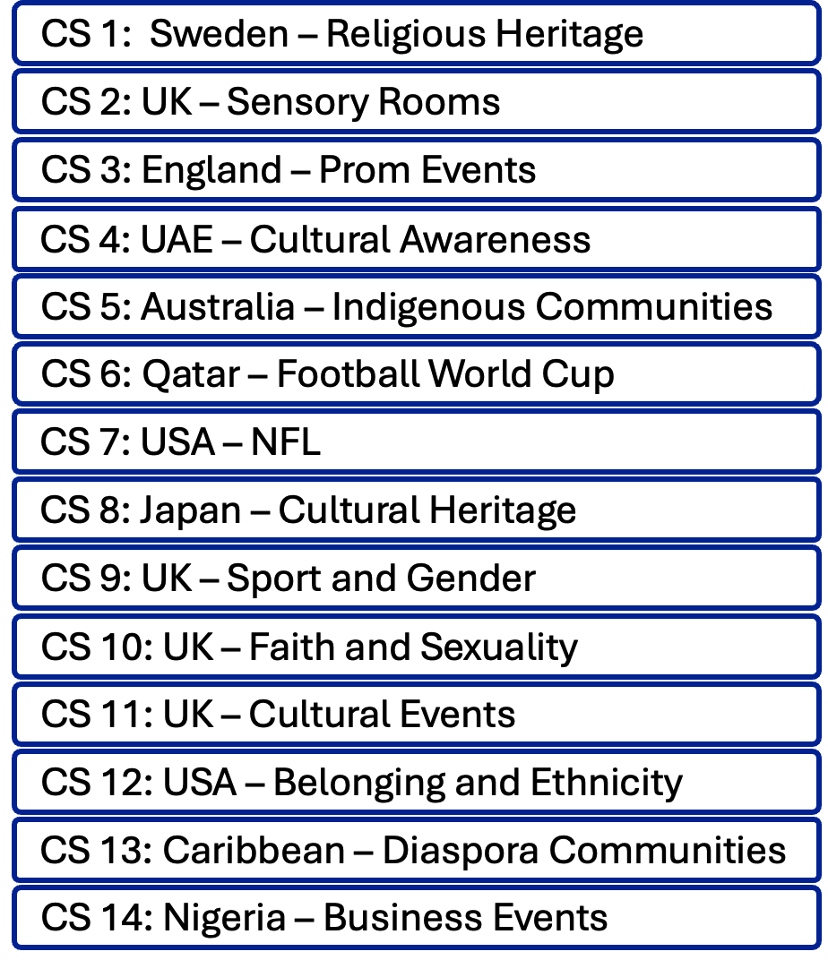
Part C: Case Studies
Real life international case studies of cultural issues in events contexts, contributed by academics and practitioners.
Provides background and context of the organization in which the cultural issues occurred, with detailed scenarios of cultural issues in the event
Explains how and why the cultural issues came about, suggesting potential mitigation of each cultural issue, with specific actions
Identifies benefits of undertaking a cultural risk assessment prior to and/or during the scenario
More than one cultural risk (intersectionality) in each scenario. Cultural risks include religious, ethnic, heritage, social, ethical, language, dietary restrictions and requirements, dress codes, sal interaction, gender, sexuality, neurodiversity, local factors, and other aspects

